Slide 1
Annals of Dagobah A Data analysis of Star wars & Star Trek Fandom
Presented by:
The data swamp sages of dagobah
‘darth’ stan smith
Luke ‘skywalker’ Williams
Sanhita ‘picard’ Banerjee
‘Nyota’ Yurora saylor

Slide 2
Star Wars Survey Data
Questions Considered for Analysis
Are you a Star Wars Fan?
Are you a Star Trek fan?
What is your education level?
Source: - https://github.com/fivethirtyeight/data/tree/master/star-wars-survey
Notes:
From the beginning when Star Trek was first introduced as a TV series in 1966 and Star Wars became a movie blockbuster hit when it debuted in 1977, there has been an intense rivalry between Trekkies or Trekkers (Star Trek fans) and Star Wars fans. Both franchises have something to offer for anyone interested in the Sci-Fi and Action genres.
The purpose of this project is to look at the correlations of the Educational demographics for a Star Wars fan and Star Trek fan.

Slide 3
The Question? Is there a correlation between Education level and being a Star Trek Fan?
Notes:
Does ones level of education background make them more susceptible with being a Star Wars fan only, a Star Trek fan only or both?

Slide 4
Hypothesis There is a positive correlation between education level and being a star trek fan Null Hypothesis There is no direct correlation between education level and being a star trek fan

Slide 5
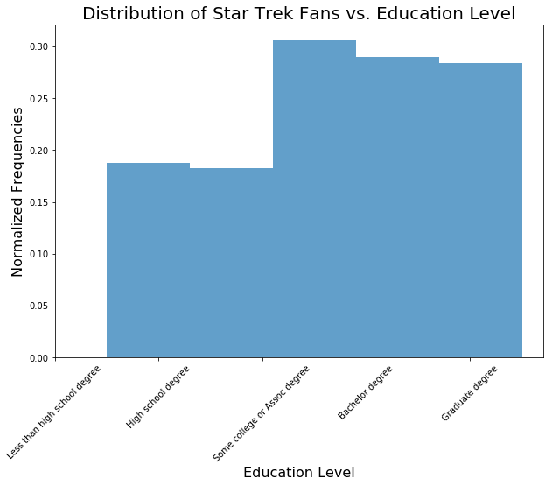
Star Trek Fans By Education Level

Slide 6
Star Trek/Star Trek fans by education level

Slide 7
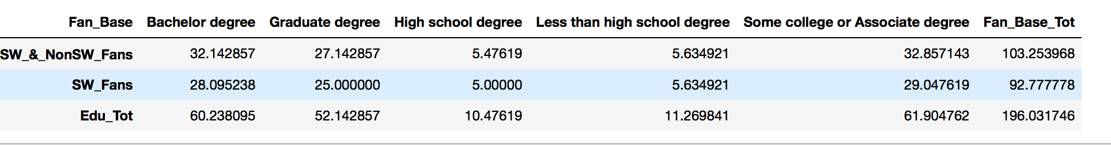
Contingency table to calculate correct, Expected distribution for Chi Square test between two observation distributions.

Slide 8
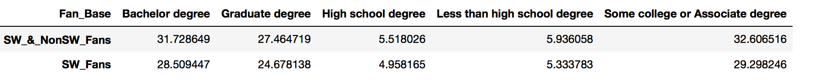
Expected Values table based on Contingency table
Create a Contingency table to caclulate correct, Expected distribution for Chi Square test between two
# observation distributions.
Create a Contingency table to caclulate correct, Expected distribution for Chi Square test between two
# observation distributions.

Slide 9
Conclusions
Chi Square Critical Value: 9.487729036781154
The Chi Square Statistic for Star Trek fans: 0.026699679229070898
The P-value for Star Star Trek fans: 0.9999116799965521
The Chi Square Statistic for Star Wars fans who are Star Trek fans: 0.029714527525253543
The P-Value for Star Wars fans who are Star Trek fans: 0.9998907179791081
The total Chi Square Statistic: 0.026699679229070898 + 0.029714527525253543 = 0.056414206754324445
The total Chi Square Statistic of 0.056414206754324445 is less than our Critical value of 9.487729036781154.
Thus, the difference between our two distributions is not significant.
The total P-Value Statistic: 0.9999116799965521 x 0.9998907179791081 = 0.9998024076274487
The total P-Value Statistic of 0.9998024076274487 is far greater than our significance P-Value of '.05’.
Thus, the difference between our two distributions is not significant.

Slide 10
The final word
We accept our Null Hypothesis

